Slide 1
Unit & Integration Testing

Slide 2

Scenario
Your company is hired by a bank to develop an online banking application.
1) Login on Valid Credentials
2) View Current Balance
Requirement Analysis
3) Deposit
4) Withdraw
5) Transfer

Slide 3
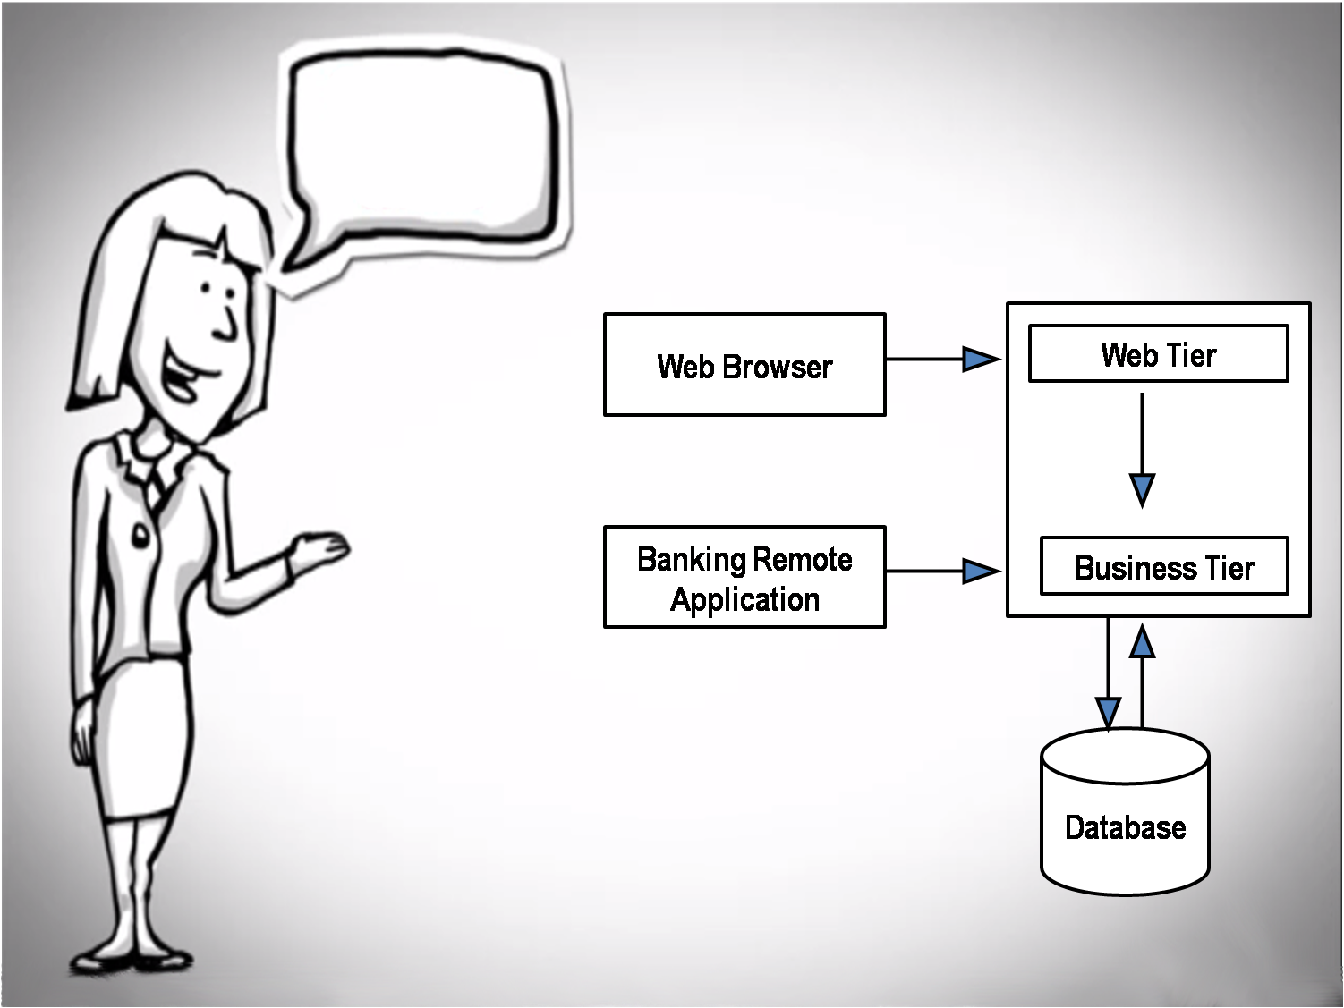
Scenario
Functional Specification
Notes:
Architecture, database and operating environment design are finalised

Slide 4
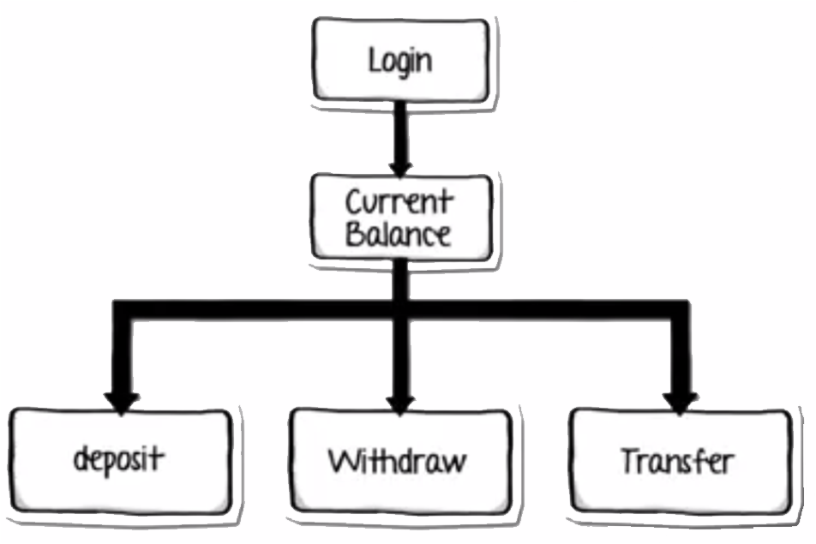
Scenario
High Level Design
Notes:
The application is broken down into modular programs

Slide 5

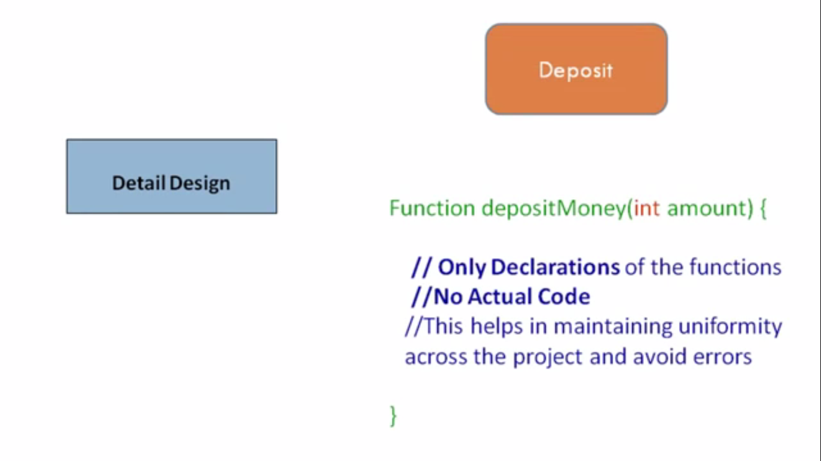
Scenario
Deposit
Detail
Design
Notes:
The pseudo code for functions of each module is documented

Slide 6
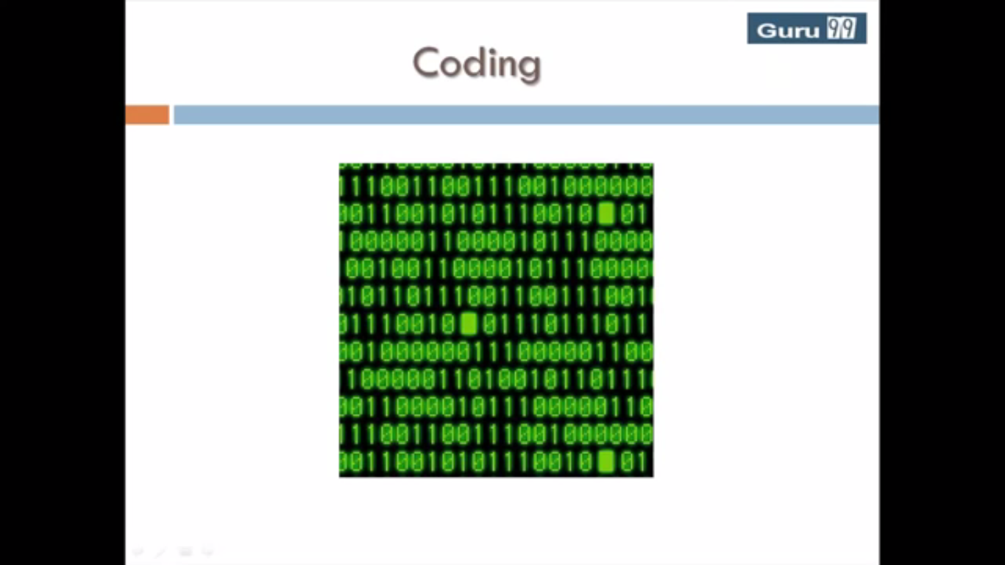
Scenario
Coding
Notes:
Actual coding begins

Slide 7
V-Model of Testing
SDLC
User Acceptance Test Plan
STLC
Requirement Analysis
User Acceptance Testing
System Test Plan
Functional Specification
System Testing
Integration Test Plan
High-Level Design
Integration Testing
Unit Test Plan
Detailed Design
Unit Testing
Code
Notes:
This is the SDLC of V model
during all these phases the tester is not sitting idle for the coding to complete but is doing corresponding testing activities

Slide 8
Unit Testing
Unit testing of software applications is done during the development (coding) of an application.
The objective of unit testing is to isolate a section of code and verify its correctness. In procedural programming a unit may be an individual function or procedure

Slide 9

The goal of unit testing is to isolate each part of the program and show that the individual parts are correct. Unit testing is usually performed by the developer.

Slide 10

Why Is Unit Testing Important?

Slide 11
Importance of Unit Testing
Sometimes software developers attempt to save time by doing minimal unit testing.
This is a myth because skimping on unit testing leads to higher defect fixing costs during system, integration and even beta testing after the application is completed
Proper unit testing done during the development stage saves both time and money in the end.

Slide 12
Unit Testing
It is also called component testing
It is performed on standalone module to check whether it is developed correctly.

Slide 13
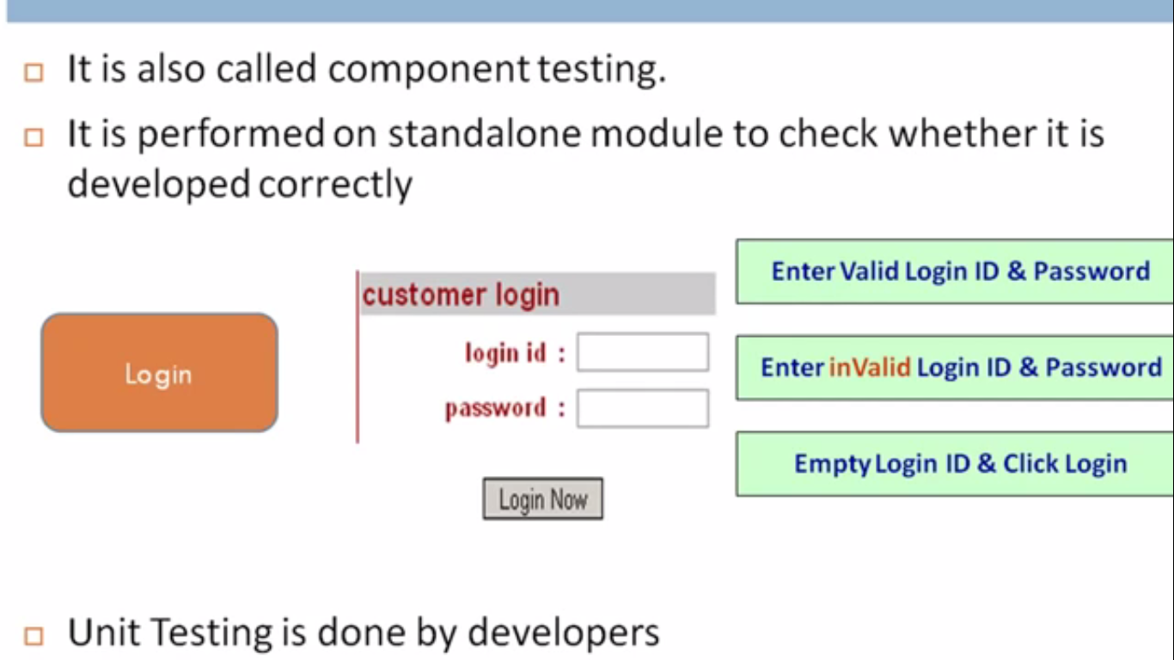
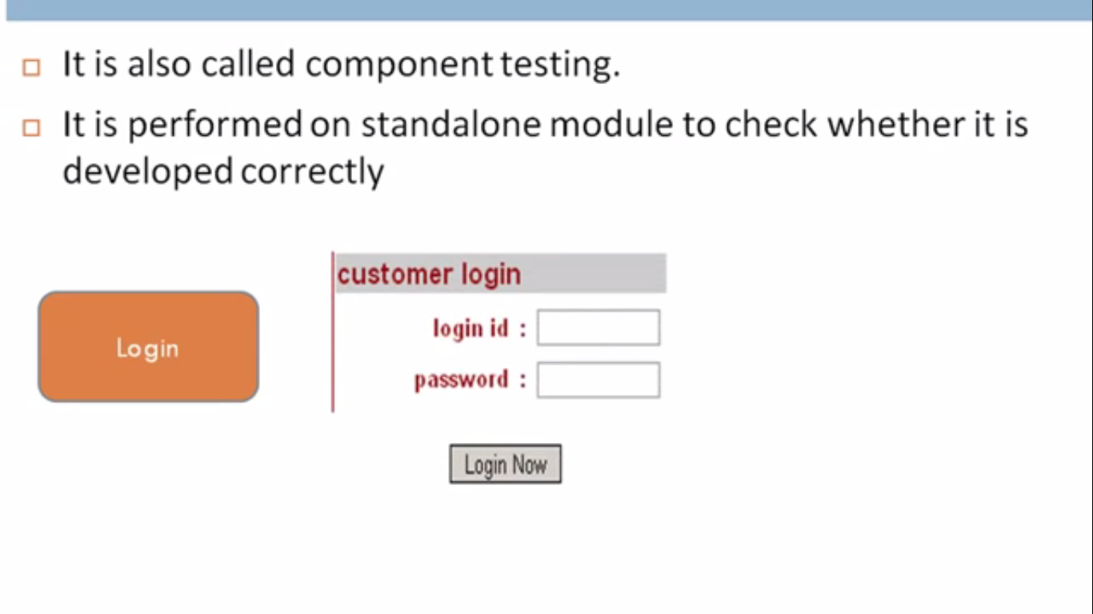
Typical unit test cases
Module

Slide 14
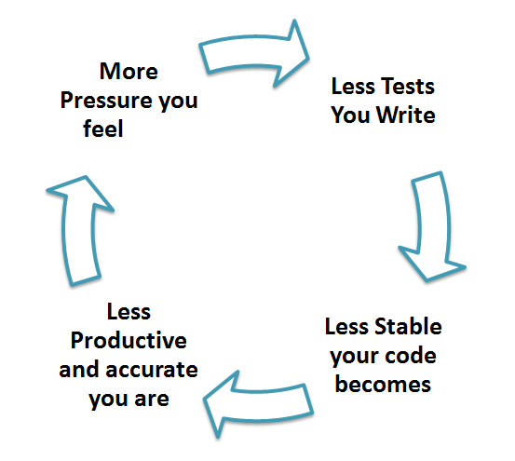
Unit Testing Myth
It requires time and I am always overscheduled
My code is rock solid! I do not need unit tests.
Myths by their very nature are false assumptions. These assumptions lead to a vicious cycle as follows –

Slide 15
Truth is:
Unit testing increase the speed of development.
Programmers think that integration testing will catch all errors and do not unit test.
Once units are integrated, very simple errors which could have very easily found and fixed in unit tested take very long time to be traced and fixed.

Slide 16
Unit Testing Best Practices
Unit Test cases should be independent. In case of any enhancements or change in requirements, unit test cases should not be affected.
Test only one code at a time.
Follow clear and consistent naming conventions for your unit tests
In case of change in code in any module, ensure there is a corresponding unit test case for the module and the module passes the tests before changing the implementation
Bugs identified during unit testing must be fixed before proceeding to the next phase in SDLC

Slide 17

Adopt a "test as you code" approach. The more code you write without testing the more paths you have to check for errors.

Slide 18
Unit testing phases
Static Unit Testing
Dynamic Unit Testing

Slide 19
Static Unit Testing
Non-execution based unit testing
Inspection- a step-by-step peer group review of a work product, with each step checked against predetermined criteria.
Walkthrough- a review where the author leads the team through a manual or simulated execution of the product using predefined scenarios.

Slide 20
Dynamic Unit Testing
Execution-based unit testing
It consists of two parts
A caller of the unit. (Test Driver)
All the units called by the unit. (Stubs)

Slide 21
Test Drivers
A program that invokes the unit under test.
The unit under test executes with input values received from the driver and, upon termination, returns a value to the driver.
The driver compares the actual outcome returned by the unit under test, with the expected outcome from the unit and reports the test result.
The test driver functions as the main unit in the execution process.
The driver not only facilitates compilation, but also provides input data to the unit under test in the expected format.

Slide 22
Stubs
A “dummy subprogram” that replaces a unit that is called by the unit under test.
Stubs replace the units called by the unit under test.
A stub performs two tasks.
Shows an evidence that the stub was, in fact, called. Such evidence can be shown by merely printing a message.
Second, the stub returns a pre-computed value to the caller so that the unit under test can continue its execution.

Slide 23
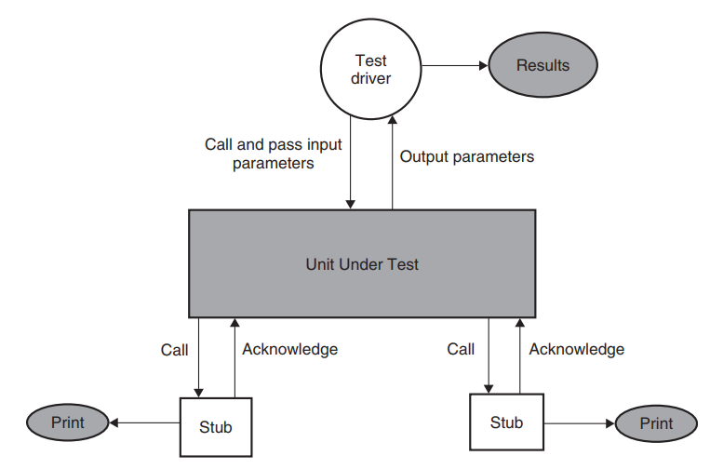
Dynamic Unit Test Environment

Slide 24
The driver and the stubs are never discarded after the unit test is completed.
Instead, those are reused in the future in regression testing of the unit if there is such a need.
For each unit, there should be one dedicated test driver and several stubs as required.
If just one test driver is developed to test multiple units, the driver will be a complicated one.

Slide 25
Integration Testing
In this phase of testing, individual modules are combined and tested as a group.
Data transfer between the modules is tested thoroughly.
Integration testing is carried out by testers.

Slide 26
System Integration Techniques
Big-Bang
Incremental
Top-Down
Bottom-Up

Slide 27
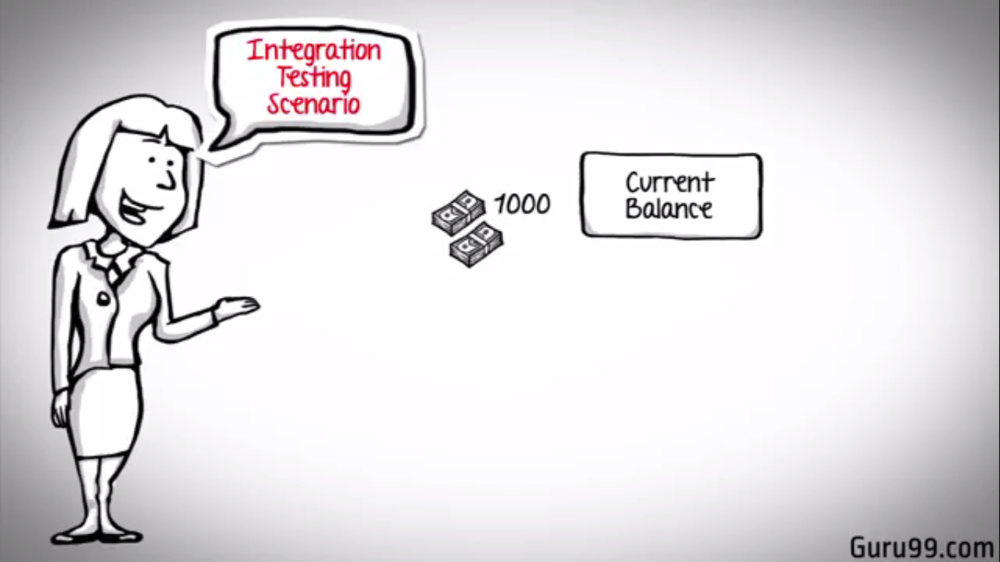

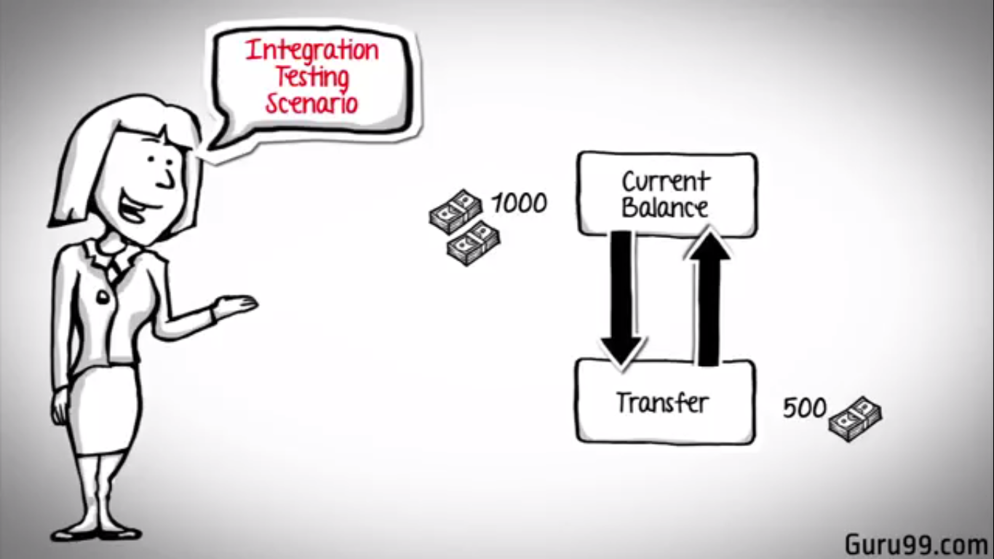
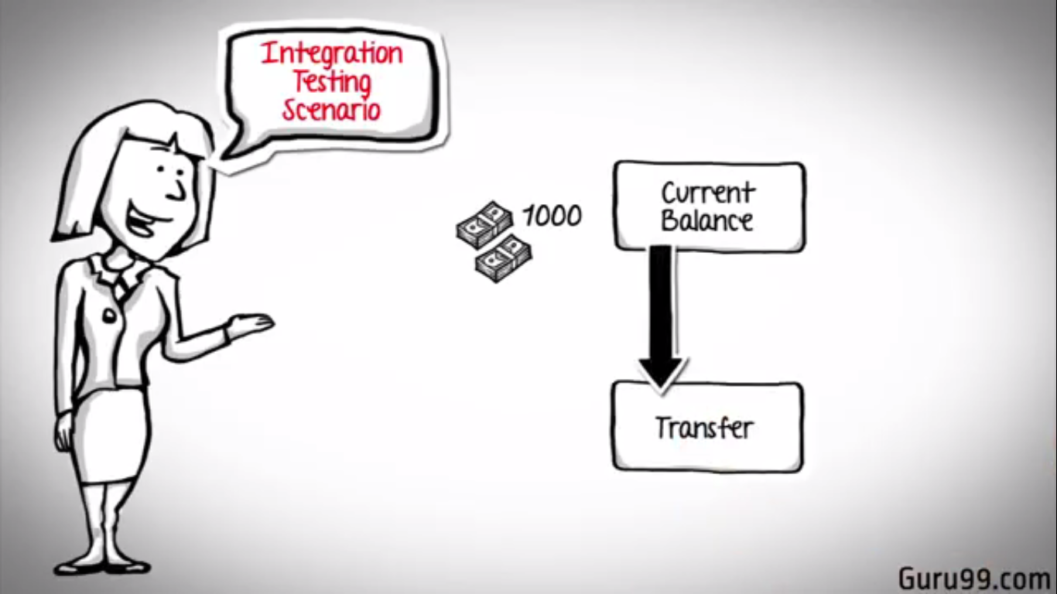
Integration Testing Scenario

Slide 28
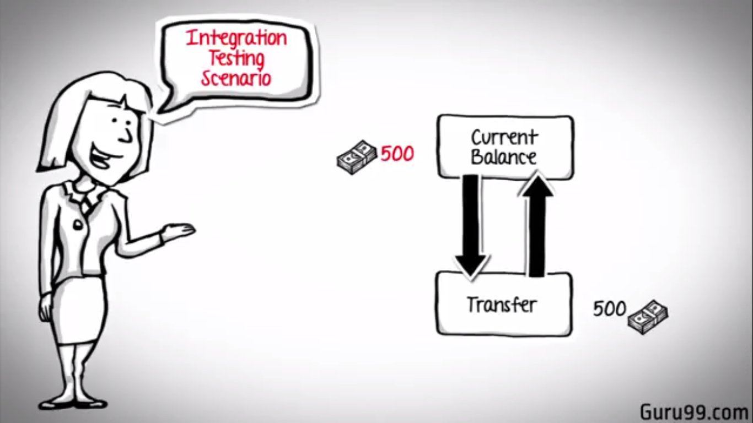
Integration Testing Scenario

Slide 29
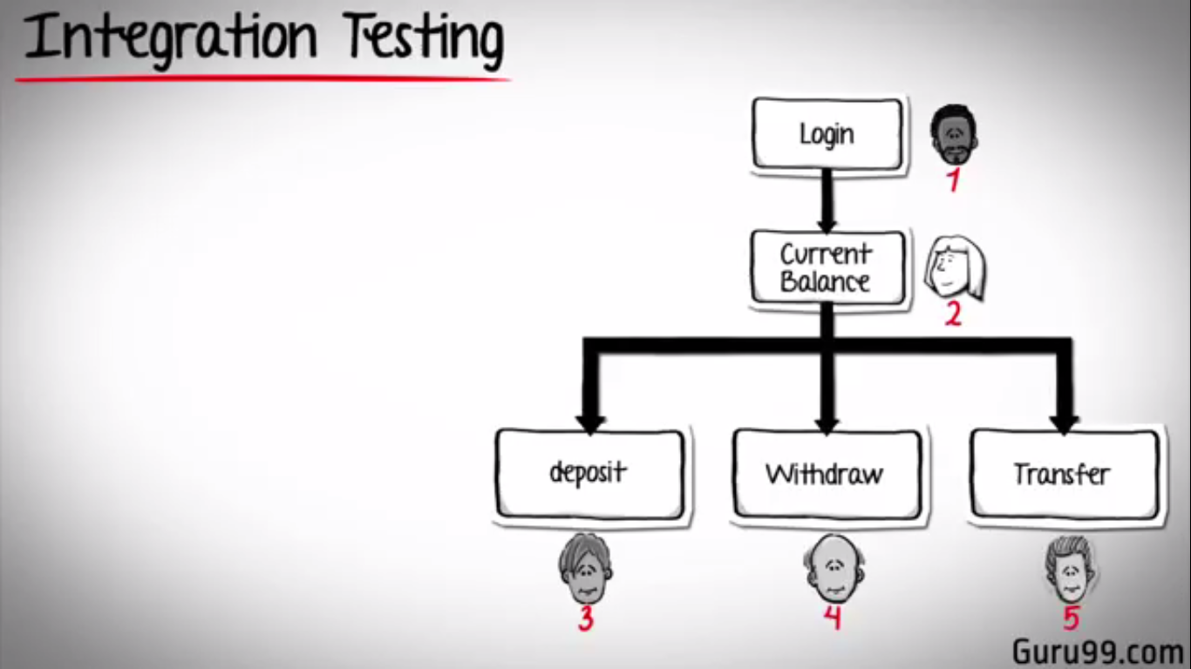
Integration Testing (cont.)
Big-Bang
Wait for all modules to be developed
Time Consuming
Difficult to trace root cause of bugs

Slide 30
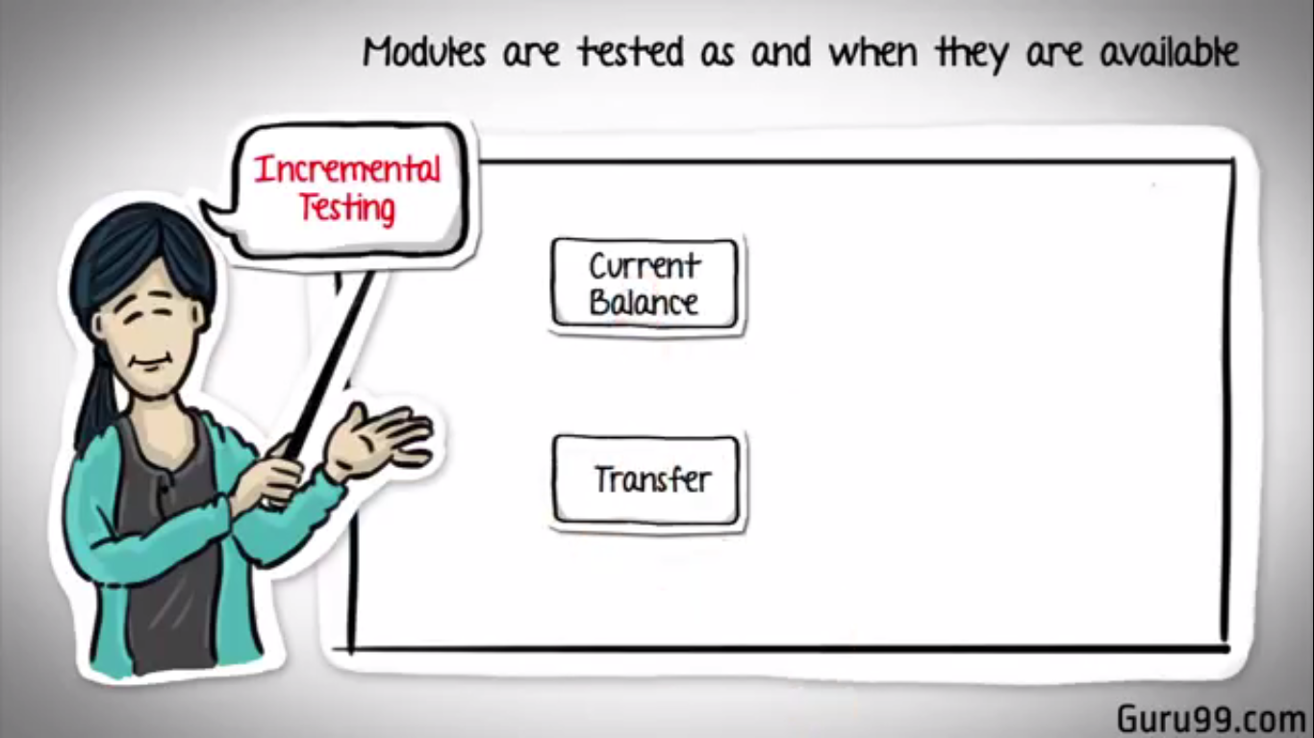
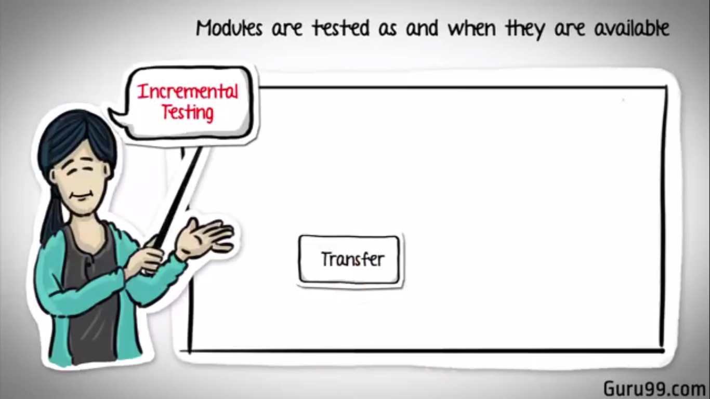
Incremental Testing
Modules are tested as and when they are available

Slide 31
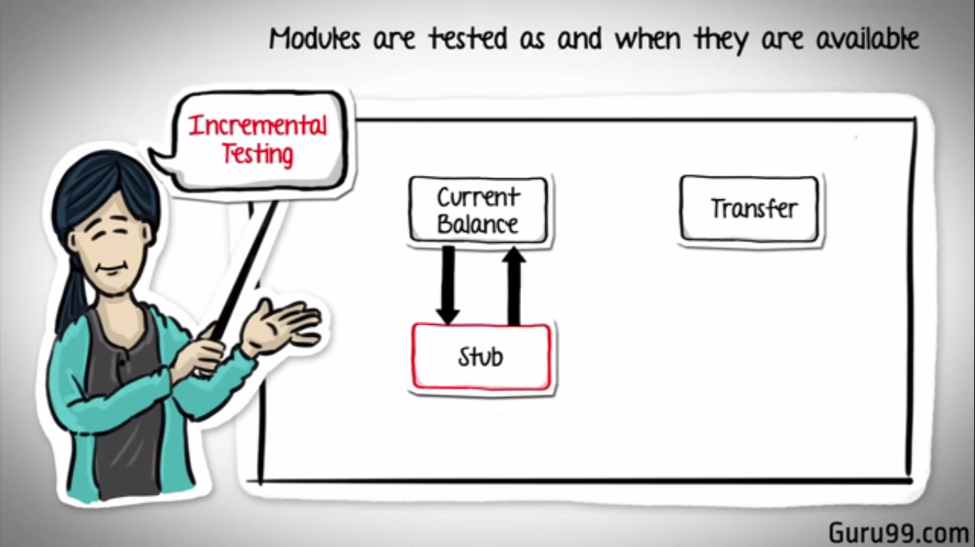
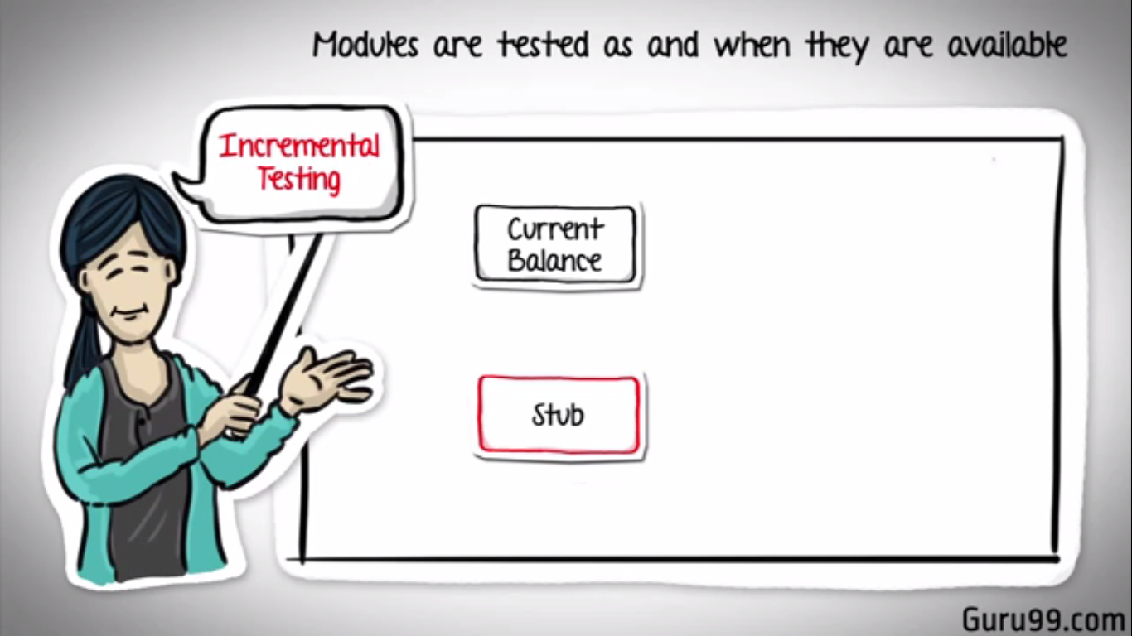
Incremental Testing
Modules are tested as and when they are available
Valid 3rd party account number
Transfer Amount < Available number

Slide 32
Incremental Testing
Modules are tested as and when they are available

Slide 33
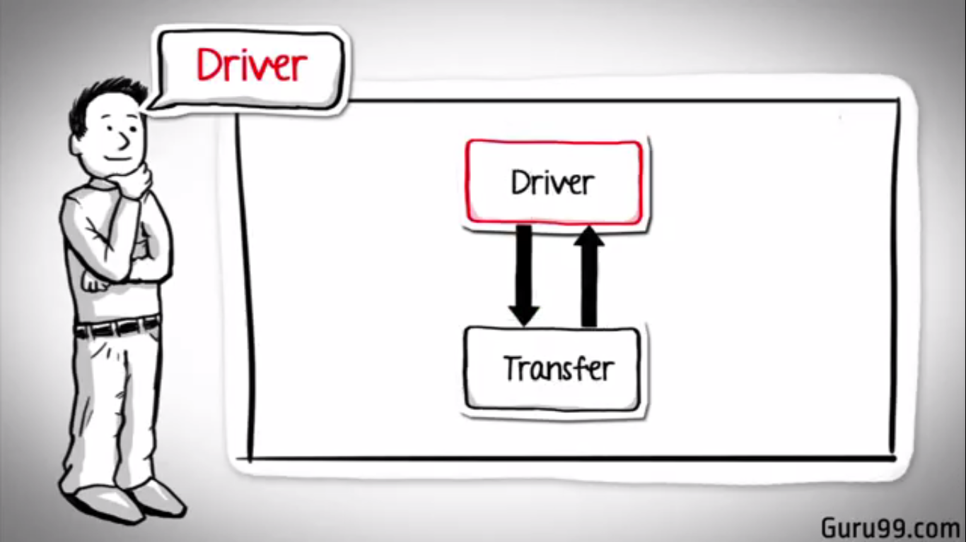
Incremental Testing
Modules are tested as and when they are available

Slide 34
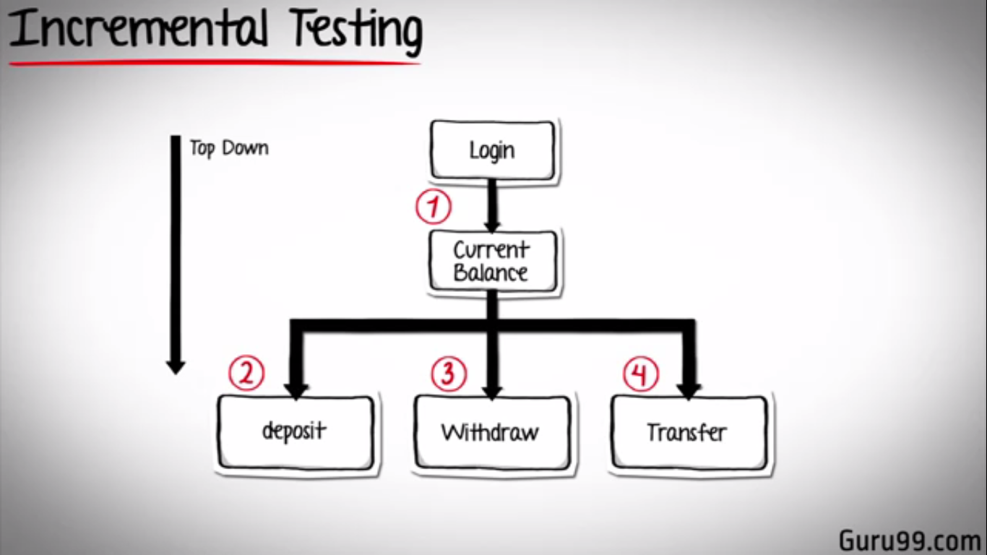
Top Down

Slide 35

Bottom Up

Slide 36
Incremental Testing
Other approaches are, would be functional increment and sandwich- which is combination of top to down and bottom to up.
The choice of approach chosen depends on the system architecture and location of high risk modules.

